Slide 1
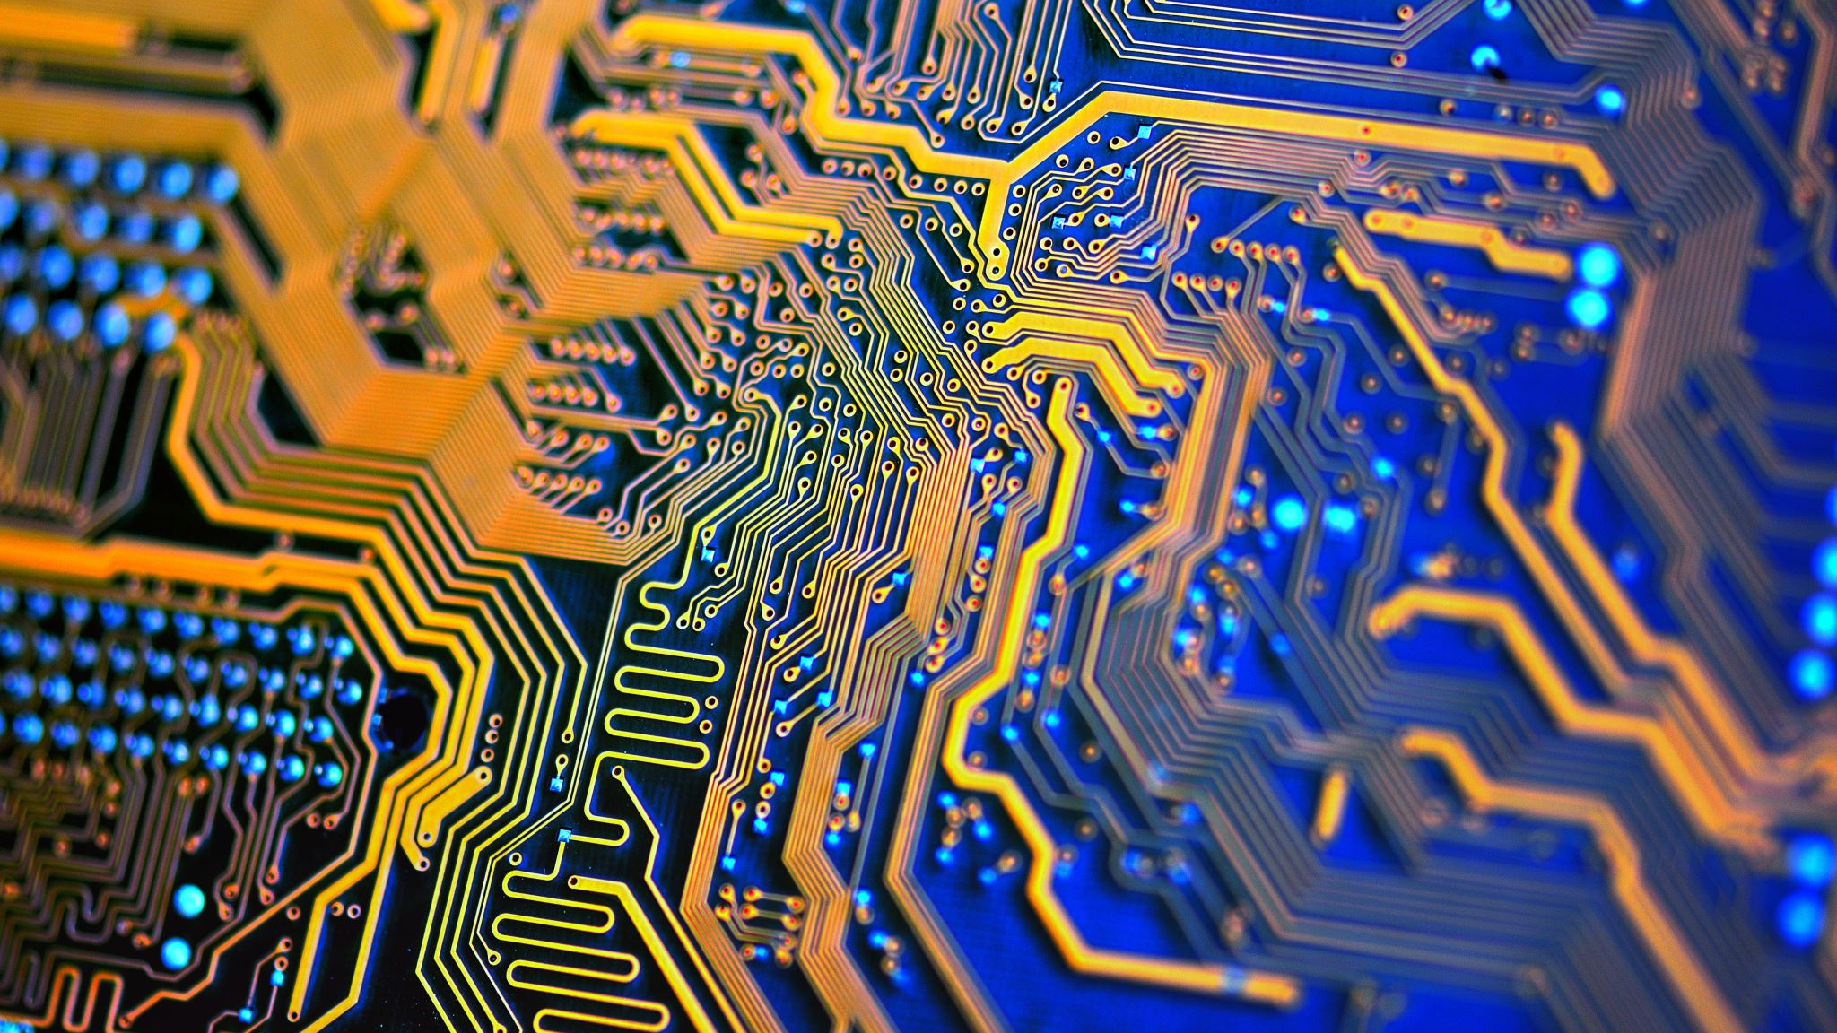
Electronics (EEE 2123)
Noman Asif Aditya
Lecturer, Dept. of CSE

Slide 2
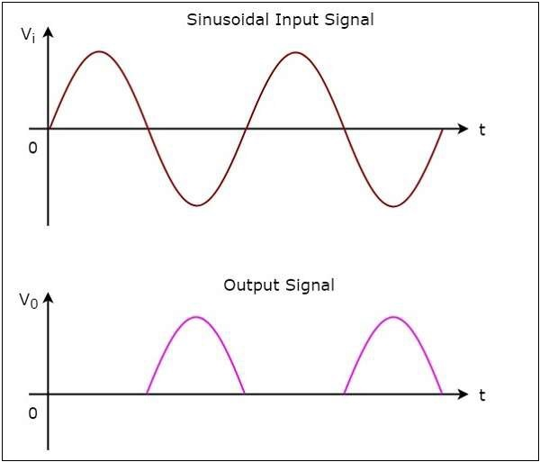
Clippers
Clippers are networks that employ diodes to “clip” away a portion of an input signal without distorting the remaining part of the applied waveform.
Clipper
Have you seen it somewhere?

Slide 3
Classification
The series configuration is defined as one where the diode is in series with the load.
The parallel variety has the diode in a branch parallel to the load.
Series
Clippers
Parallel

Slide 4
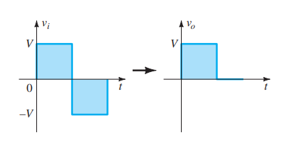
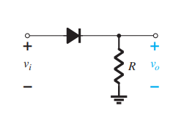
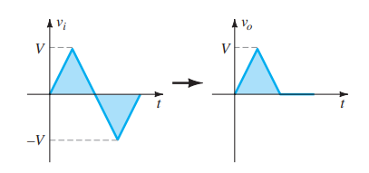
Series Clipper

Slide 5
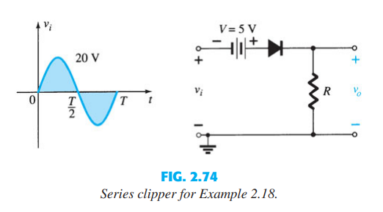
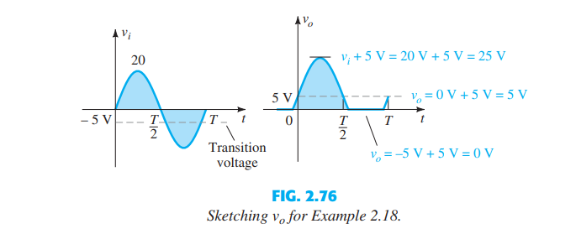
Series Clipper

Slide 6

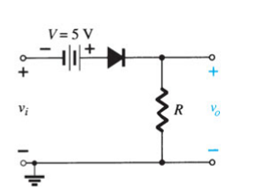
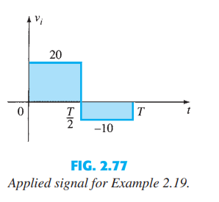
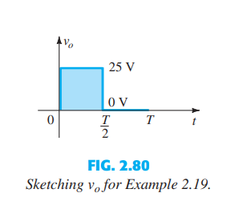
Series Clipper

Slide 7
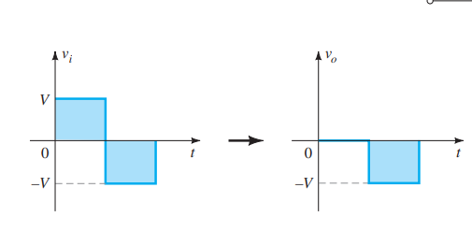
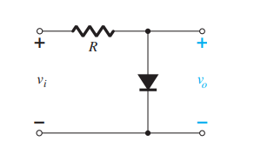
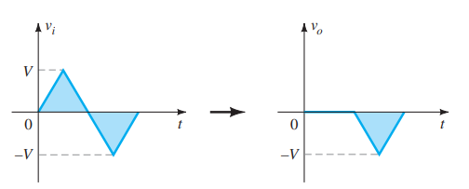
Parallel Clipper

Slide 8
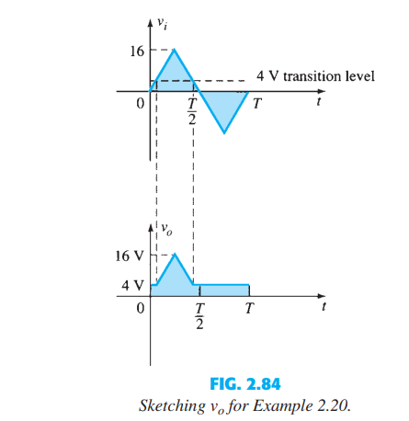
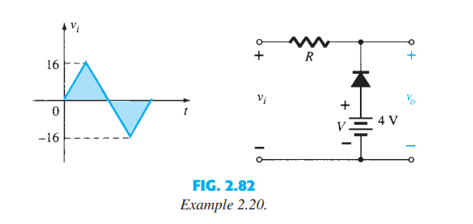
Parallel Clipper

Slide 9
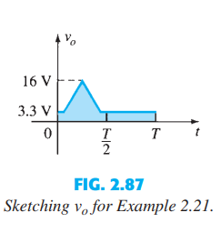
Parallel Clipper

Slide 10
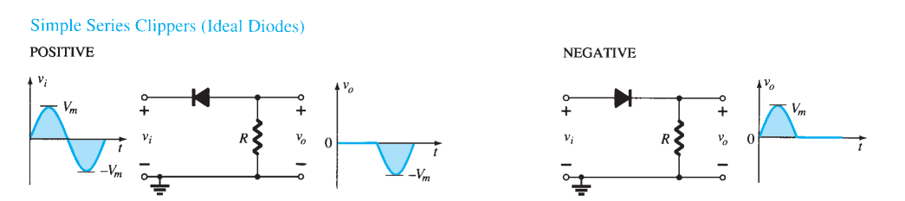
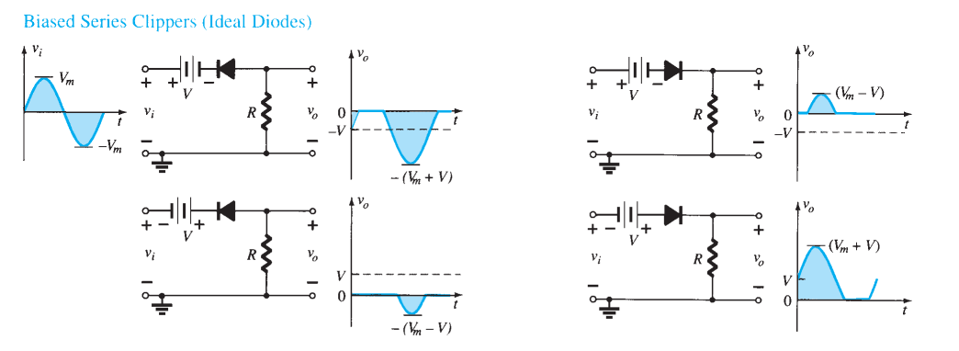
Series Clippers (Ideal Diode)

Slide 11
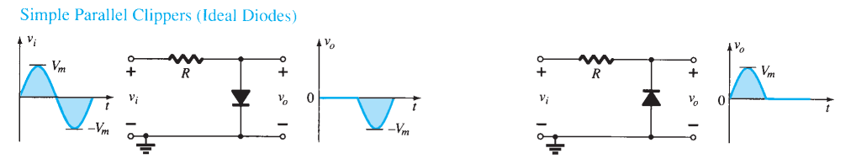
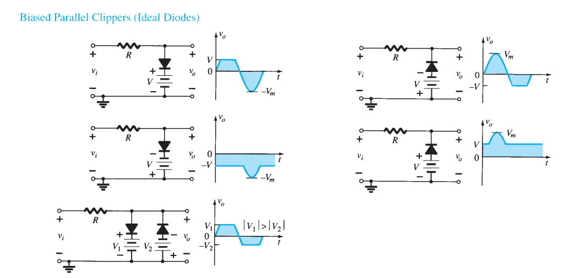
Parallel Clippers (Ideal Diode)

Slide 12
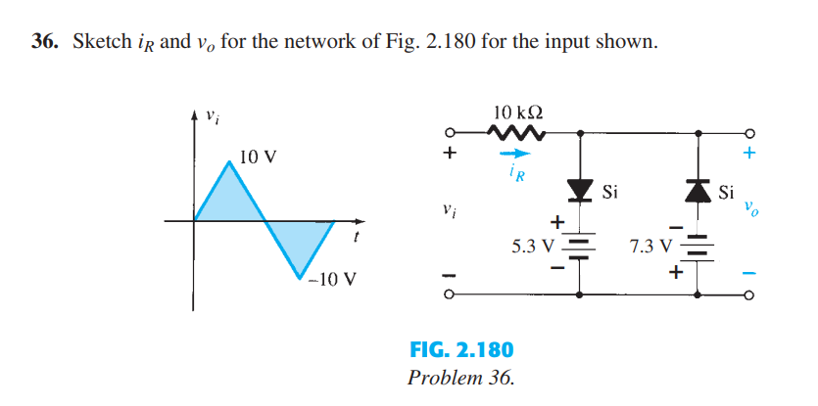
Exercise Problem

Slide 13


